Slide 1
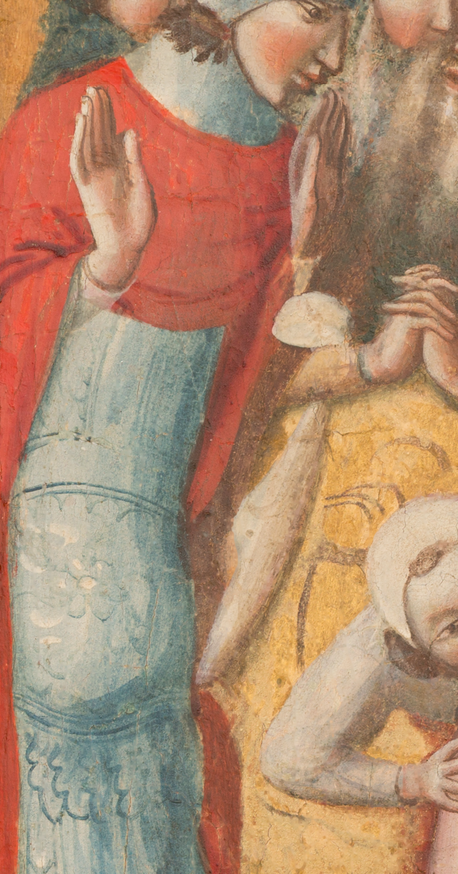
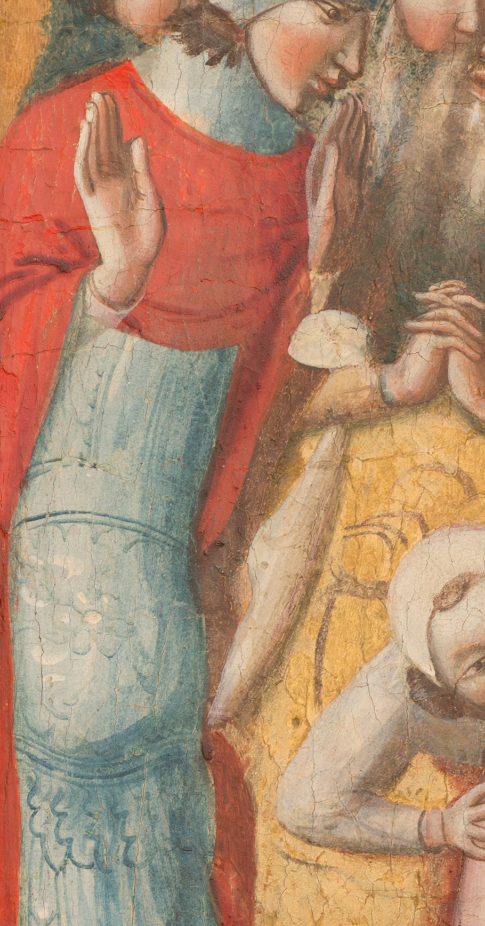
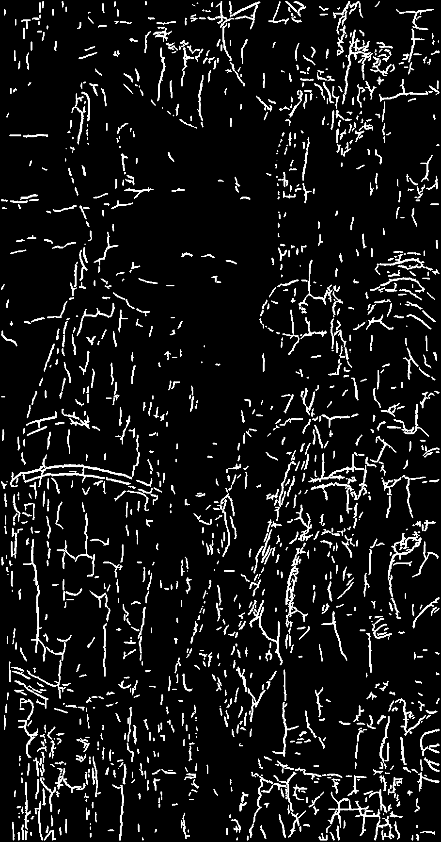
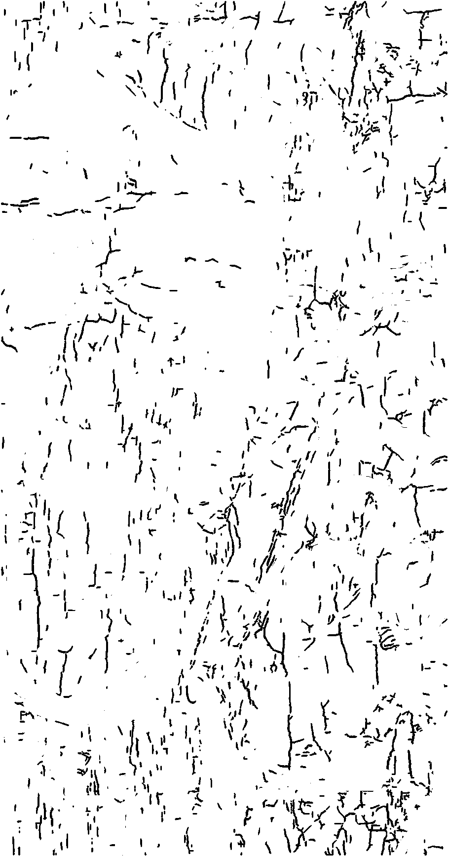
Original
Crack Maps

Slide 2
After Debugging - More details preserved

Slide 3
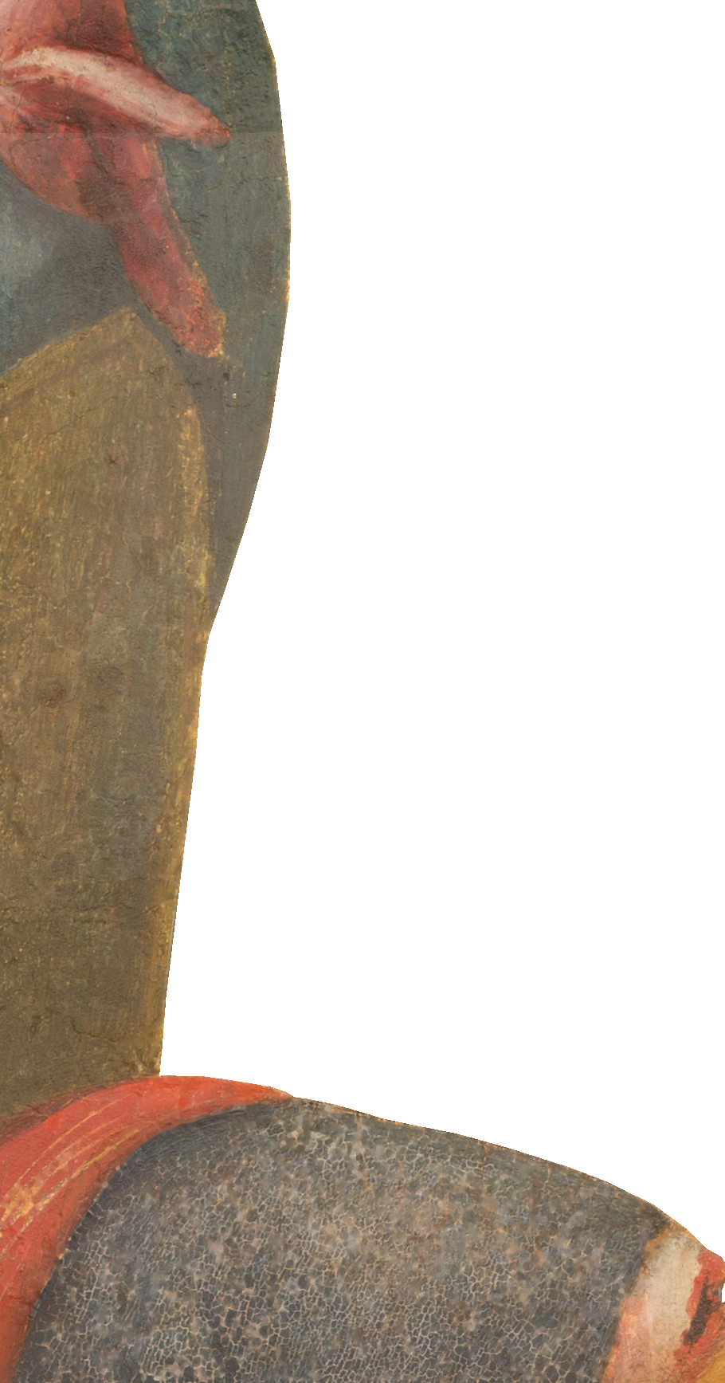
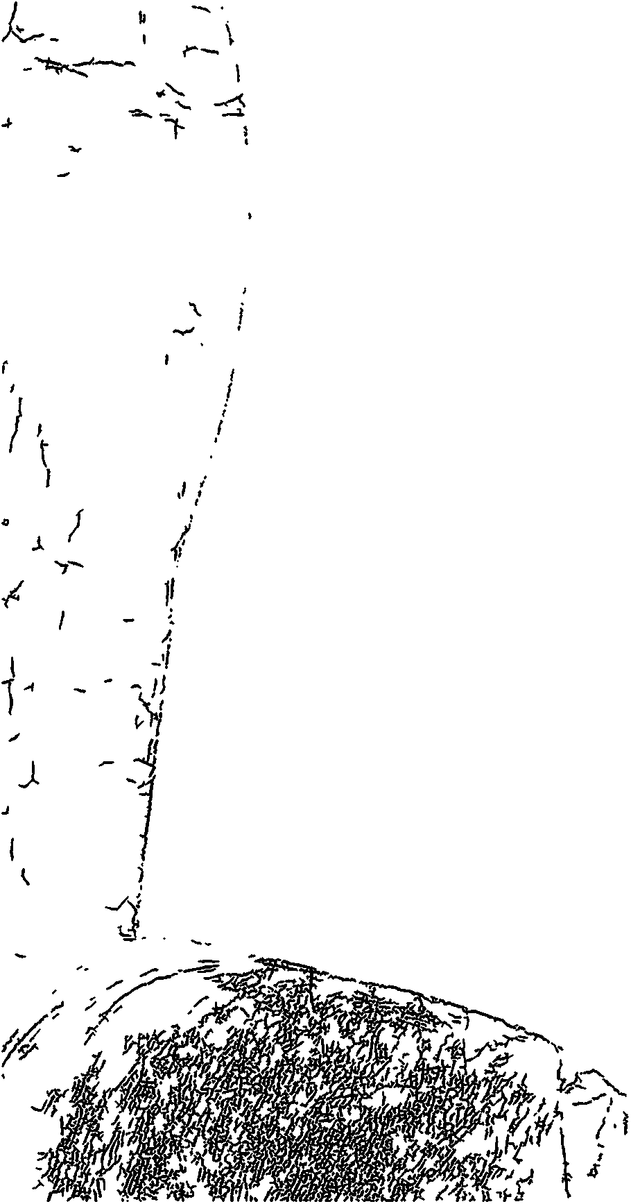


Slide 4
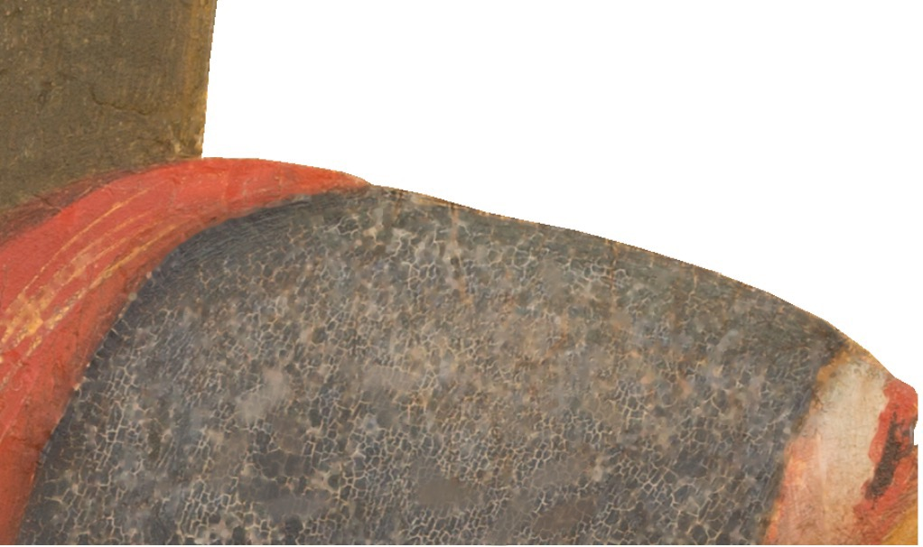

Processed- much blurred
Special Material
- To what extend we should identify cracks
- Any suggestions on choices to remove cracks
- color faded, cracks, hard to identify the original color

